Slide 1
Multimodal Emotion Recognition
Our project utilizes deep learning to create a multimodal system that identifies seven basic emotions from audio signals (Speech Emotion Recognition – SER) and facial images (Facial Expression Recognition – FER). We separately trained multiple deep learning models for each modality with the same label schema and present comparative evaluation metrics. The models were integrated with a web application interface for real-time prediction.

Slide 2
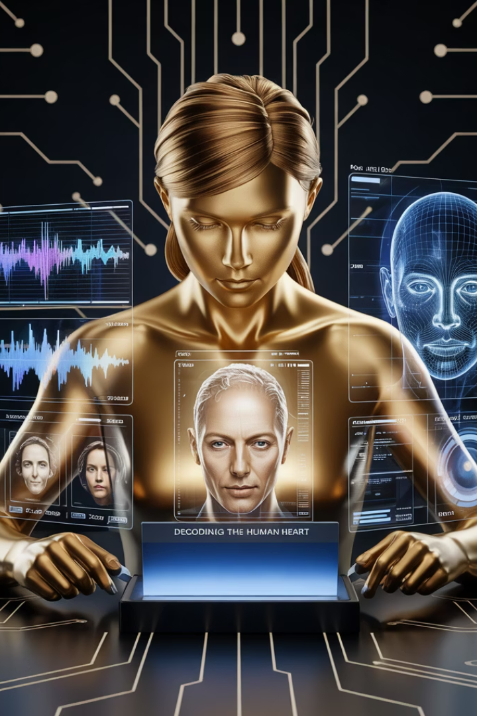



Project Overview
Speech Emotion Recognition
Facial Expression Recognition
Analyzes audio signals to detect emotional states using deep learning models trained on benchmark datasets.
Processes facial images to classify emotions using CNN architectures trained on standardized datasets.
Multimodal Integration
Combines both modalities to enhance accuracy and robustness of emotion detection for real-world applications.

Slide 3

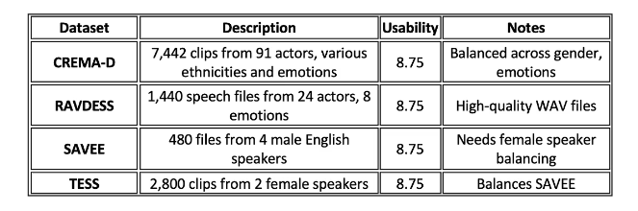
Datasets Used
Dataset
Description
Usability
CREMA-D
7,442 clips from 91 actors, various ethnicities and emotions
8.75
RAVDESS
1,440 speech files from 24 actors, 8 emotions
8.75
SAVEE
480 files from 4 male English speakers
8.75
TESS
2,800 clips from 2 female speakers
8.75
FER2013
35,887 grayscale images (48x48) labeled with 7 emotions
-
We used five benchmark datasets to ensure diversity, speaker/gender balance, and generalization. CREMA-D and RAVDESS provide balanced data across gender and emotions, while SAVEE and TESS complement each other with male and female speakers respectively. FER2013 was used specifically for the facial recognition pipeline.

Slide 4
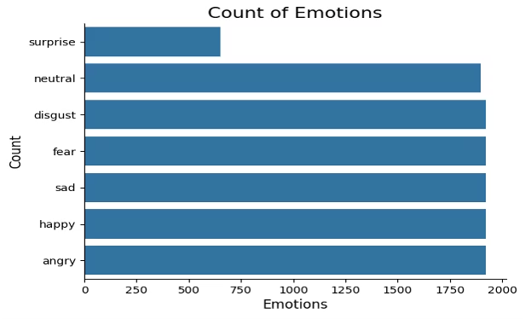
Emotion Label Mapping
Unified 7-Class Schema
Emotion Categories
All datasets were unified to follow a consistent 7-class schema to ensure standardized training and evaluation across modalities.
The seven emotion categories used were: neutral, happy, sad, angry, fear, disgust, and surprise.
Label Consistency
Careful manual inspection and relabeling was required to map different naming conventions from various datasets into our unified structure.
This standardized approach allowed us to train models that could recognize the same emotional states regardless of whether they were detected through speech or facial expressions, enabling more consistent multimodal integration.

Slide 5
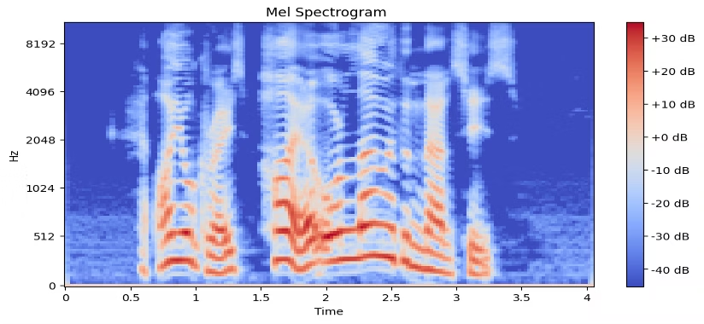
Audio Data Preprocessing
Data Acquisition
We downloaded datasets using kagglehub.dataset_download() from official Kaggle links. The datasets were loaded into memory using librosa for audio signal processing.
Audio Loading
Each .wav file was loaded using librosa.load(), with a fixed sampling rate of 22050 Hz. We applied padding where audio duration was short and skipped corrupted files.
Feature Extraction
We extracted MFCCs, Zero Crossing Rate (ZCR), and Root Mean Square Energy (RMSE) using Librosa. Features were standardized using StandardScaler, and class labels were encoded with LabelEncoder.
Data Splitting
An 80/20 split of the data into training and test subsets was obtained to ensure proper model evaluation.

Slide 6





Video Data Preprocessing
Dataset Loading
The CSV-formatted FER2013 dataset was loaded using pandas.read_csv().
Image Conversion
Each pixel column was converted into a NumPy array and reshaped into 48x48 images.
Normalization
Pixel values were scaled from [0, 255] to [0, 1] by dividing by 255.
Reshaping
Input image shapes were reshaped from (48, 48) to (48, 48, 1) to match CNN architecture requirements.
Data Splitting
Data was split using train_test_split() with a 70/15/15 ratio (Train/Val/Test).

Slide 7










Speech Emotion Recognition Models
CNN + Self-Attention
Highest accuracy at 68.32%
CNN + BiLSTM
67.34% accuracy
Basic CNN
65.05% accuracy
CNN + LSTM
62.49% accuracy
CNN + GRU + Dense
57.97% accuracy
We extracted Mel-Frequency Cepstral Coefficients (MFCCs) from four standard audio emotion datasets, resulting in over 10,000 labeled audio clips. Each model used Adam optimizer, Categorical Cross-Entropy loss function, and employed Early Stopping and ReduceLROnPlateau for regularization and convergence.

Slide 8
Facial Emotion Recognition Models
ResNet-50 (Transfer Learning)
Custom CNN for FER
We used pre-trained ResNet50 from Keras with ImageNet weights and frozen base layers. The custom head included GlobalAveragePooling followed by Dense layers. This approach achieved approximately 71% validation accuracy, demonstrating the power of transfer learning for facial emotion recognition.
Our custom CNN architecture featured Conv2D stacks with increasing filters (64 → 128 → 256), followed by Flatten, Dropout, and Dense layers. We optimized performance using data augmentation techniques including horizontal flips and brightness adjustments. This model reached approximately 65% accuracy.
Both models were trained on the FER2013 dataset, consisting of 48x48 grayscale facial images labeled with 7 emotion categories. The superior performance of the ResNet-50 model validates the importance of transfer learning in facial expression recognition tasks.

Slide 9
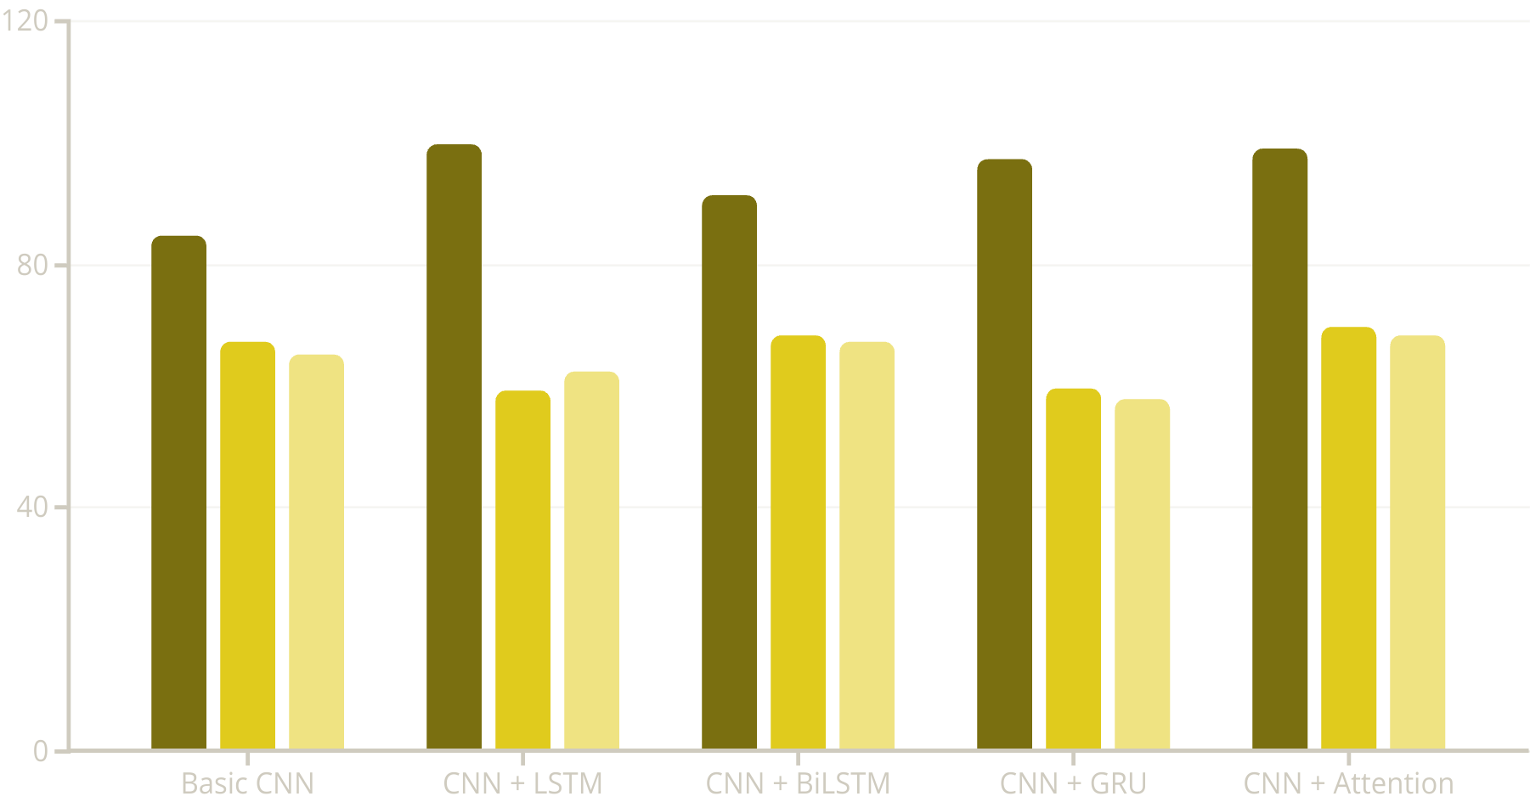
Model Performance Summary
Train Accuracy
Validation Accuracy
Test Accuracy
The chart illustrates the performance metrics of our five SER models. The CNN + Self-Attention model achieved the highest test accuracy at 68.32%, followed by CNN + BiLSTM at 67.34%. Note the significant gap between training and test accuracies in most models, indicating some degree of overfitting despite regularization techniques.

Slide 10
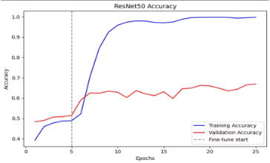
Facial Recognition Model Performance
99.72%
66.94%
ResNet-50 Training Accuracy
ResNet-50 Test Accuracy
Shows excellent learning on training data
Indicates good generalization
62.38%
64.94%
Custom CNN Training Accuracy
Custom CNN Test Accuracy
Lower but more consistent with test results
Shows less overfitting than ResNet-50
The ResNet-50 model demonstrates superior performance compared to our Custom CNN architecture, though with more pronounced overfitting. The Custom CNN shows more consistent performance between training and testing phases, suggesting better generalization despite lower overall accuracy.

Slide 11
Key Evaluation Metrics
Model Name
Precision
Recall
F1 Score
Accuracy
Basic CNN
0.66
0.65
0.65
0.65
CNN + LSTM
0.65
0.62
0.62
0.62
CNN + BiLSTM
0.68
0.67
0.67
0.67
CNN + GRU + Dense
0.59
0.58
0.58
0.58
CNN + Self-Attention
0.69
0.68
0.68
0.68
ResNet-50
0.685
0.653
0.665
0.669
Custom CNN
0.614
0.653
0.623
0.649
This comprehensive evaluation shows that CNN + Self-Attention achieved the best overall performance for audio with an F1-score of 0.68, while ResNet-50 led the visual models with an F1-score of 0.665. The metrics reveal that precision was strongest for the "happy" class across models, while "fear" and "disgust" classes showed the weakest recall in both modalities.

Slide 12
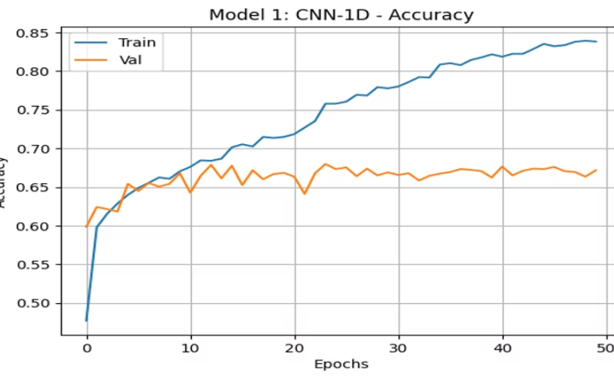
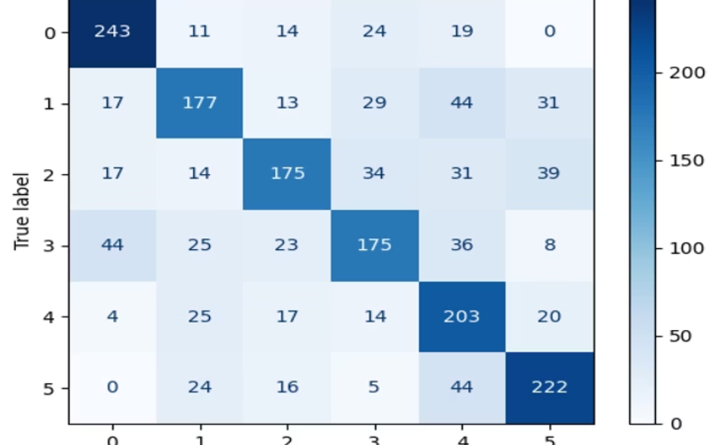
Basic CNN Performance
Accuracy Plot
Confusion Matrix
The training accuracy rises steadily to around 85% while validation accuracy plateaus near 67%, indicating some overfitting despite regularization techniques. The gap between training and validation curves suggests room for improved generalization.
The confusion matrix reveals stronger performance on "happy" and "neutral" emotions, with more confusion between similar emotion pairs like "sad"/"fear" and "angry"/"disgust". This pattern is consistent with human perception challenges for these emotion pairs.

Slide 13
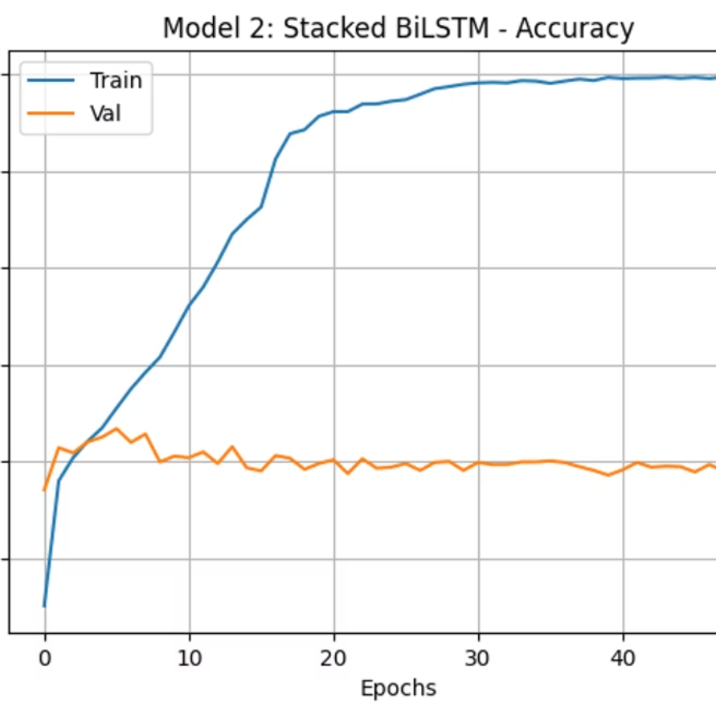
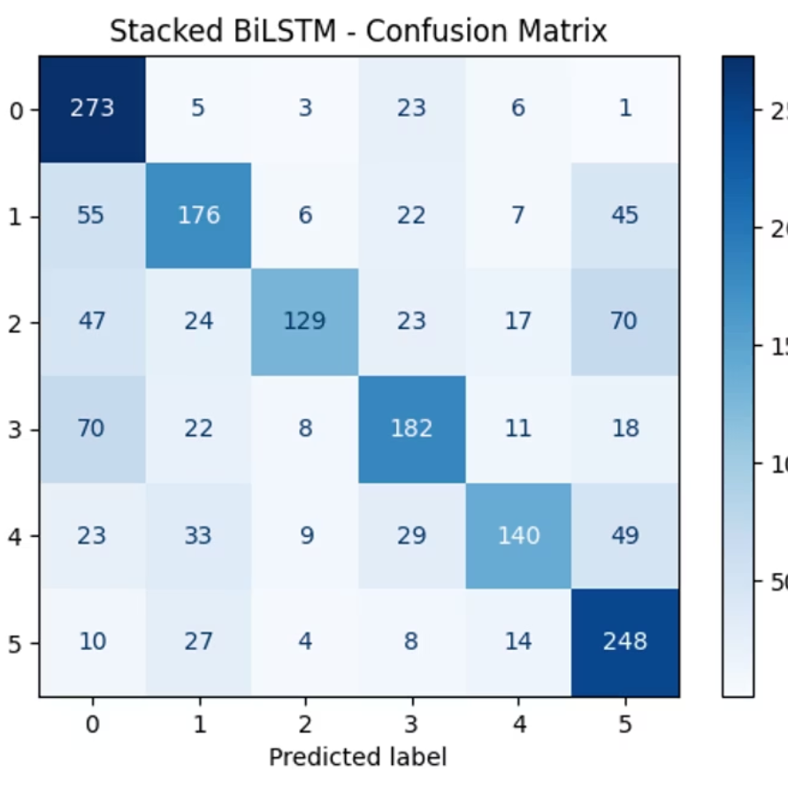
CNN + LSTM Performance
Accuracy Plot
Confusion Matrix
The CNN + LSTM model shows significant overfitting with training accuracy approaching 100% while validation accuracy remains around 59%. This suggests the model memorized training data rather than learning generalizable patterns despite dropout layers.
The confusion matrix shows improved detection of temporal emotion patterns compared to the basic CNN, particularly for "surprise" and "angry" emotions. However, it struggles with distinguishing between "fear" and "sad" emotions, which share similar acoustic properties.

Slide 14
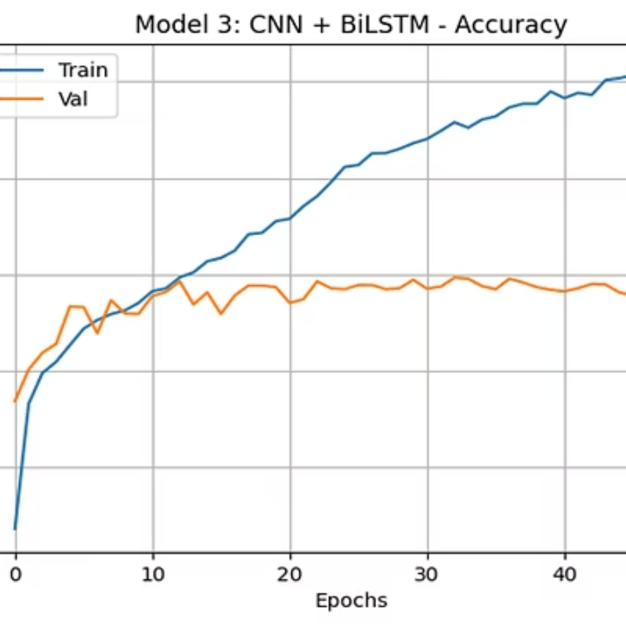
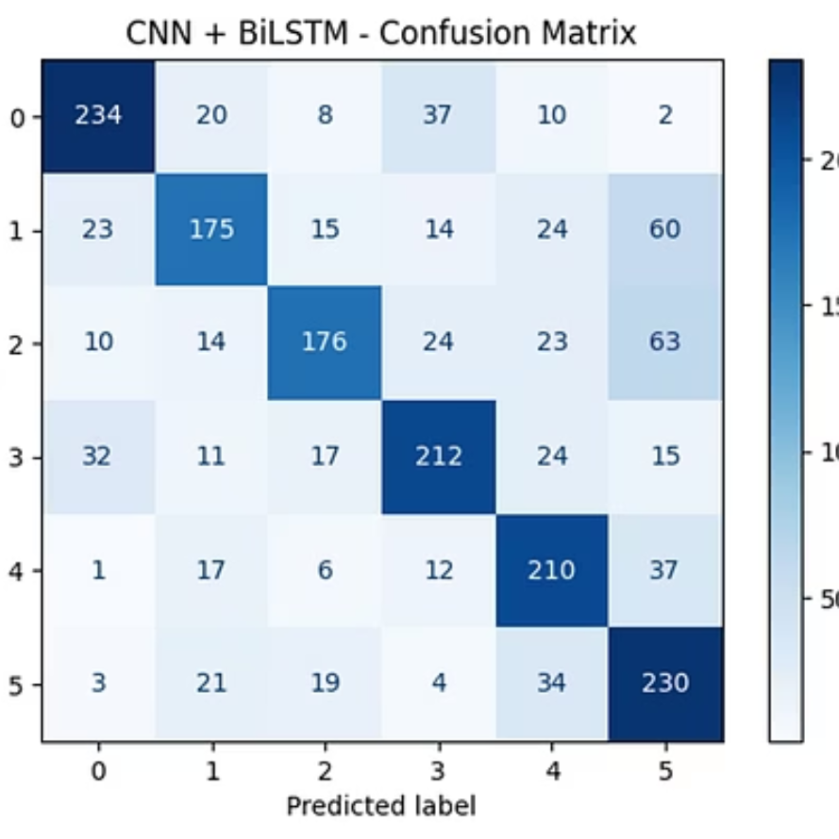
CNN + BiLSTM Performance
The CNN + BiLSTM model shows improved performance over the standard LSTM variant, with better balance between training (91.19%) and validation accuracy (68.41%). The bidirectional approach captures both forward and backward context in audio features, resulting in better performance on emotions like "disgust" and "fear" that rely on tone shifts. The confusion matrix shows reduced misclassifications between similar emotion pairs.

Slide 15
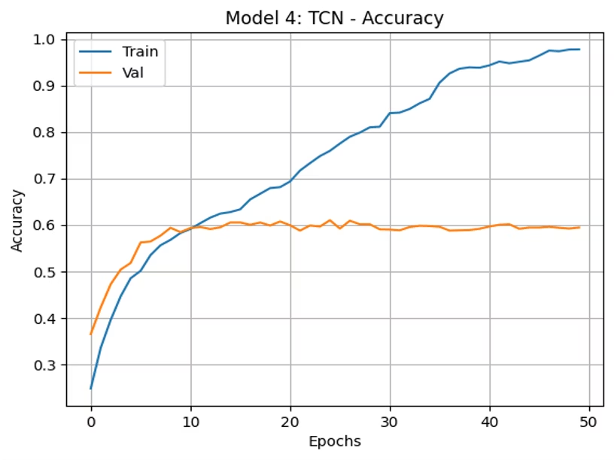



CNN + GRU + Dense Performance
Training Pattern
Model Architecture
Classification Results
Training accuracy reached 97.43% while validation accuracy peaked at 59.42%, showing significant overfitting despite using GRU units which are typically more resistant to this problem.
Replaced LSTM with GRU for lighter computation while maintaining similar theoretical capabilities. Added dense layers with dropout to combat overfitting, though with limited success.
Showed the weakest overall performance at 57.97% test accuracy, with particular difficulty distinguishing between "neutral" and "sad" emotions.

Slide 16



CNN + Self-Attention Performance
Best Performer
Achieved highest test accuracy of 68.32%
Attention Mechanism
Incorporated self-attention to emphasize important MFCC regions
Balanced Learning
Better performance across all emotion classes
The CNN + Self-Attention model represents our most sophisticated architecture for speech emotion recognition. By incorporating an attention mechanism, the model can focus on the most emotionally salient parts of the audio signal. This approach achieved the highest test accuracy of 68.32% and showed more balanced performance across all emotion classes, particularly improving on traditionally difficult emotions like "fear" and "disgust".

Slide 17
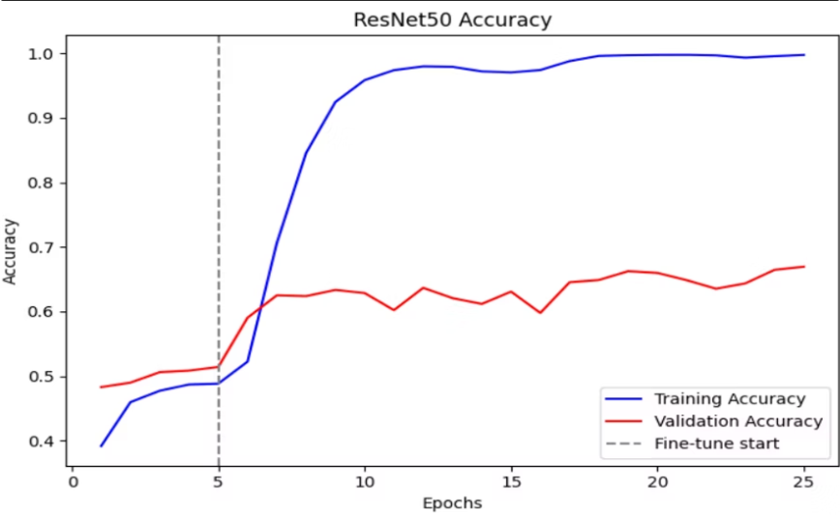
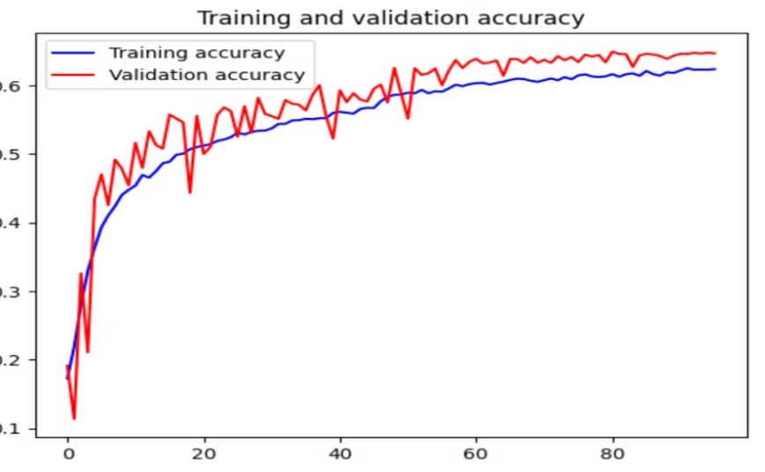
ResNet-50 & Custom CNN Performance
ResNet-50 Results
Custom CNN Results
The ResNet-50 model leveraged transfer learning to achieve 66.94% test accuracy. The confusion matrix shows strong performance on "happy" emotions but struggles with "fear" and "disgust" classes. The training curve reveals significant overfitting despite using pre-trained weights.
Our custom CNN architecture reached 64.94% test accuracy with less overfitting than ResNet-50. The model shows more balanced performance across emotion classes but with lower overall accuracy. Data augmentation techniques helped improve generalization.

Slide 18










Challenges Faced
Data Imbalance
Dataset Integration
Underrepresented emotions like disgust, fear, and surprise led to biased predictions
Different formats and label naming conventions required careful manual inspection and relabeling
Audio Processing
WAV files failed due to encoding issues, length inconsistencies, and sampling rate mismatches
Computational Limits
GPU constraints, session timeouts, and memory limits slowed experimentation
Overfitting
Deep models showed high training accuracy but poor generalization despite regularization

Slide 19

Future Use Cases and Extensions
Real-Time Emotion Monitoring
Deploy trained models using web or mobile interfaces for live microphone input and webcam streams, enabling continuous affect tracking during calls or video chats.
Speech-to-Text-Based Detection
Include textual modality using speech-to-text conversion with models like Whisper or Google Speech API, then apply transformer-based models to detect emotion from text content.
Multimodal Fusion
Extend current late-fusion strategy into a fully integrated model that processes audio, visual, and text inputs simultaneously using multimodal transformers or cross-attention architectures.
Emotion-Aware Assistants
Integrate emotion detection into chatbots, customer service systems, and healthcare assistants to identify user states like frustration, satisfaction, stress, or anxiety.

Slide 20
Project Contributions and References
Team Contributions
Key References
CREMA-D, RAVDESS, TESS, and SAVEE datasets from Kaggle
Team Member
Project Part
Contribution(%)
nadavala
Speech emotion recognition pipeline
33.33%
FER2013 Facial Emotion Recognition Dataset
TensorFlow Documentation
Librosa Audio Processing Library
rdargula
Facial expression recognition models
33.33%
GitHub repositories for multimodal emotion recognition
sumanthy
Model integration and reporting
33.33%

